Slide 1


Warsaw my city
PaweL Cebulski
Klasa Va
SzkoLa Podstawowa nr 321

Slide 2
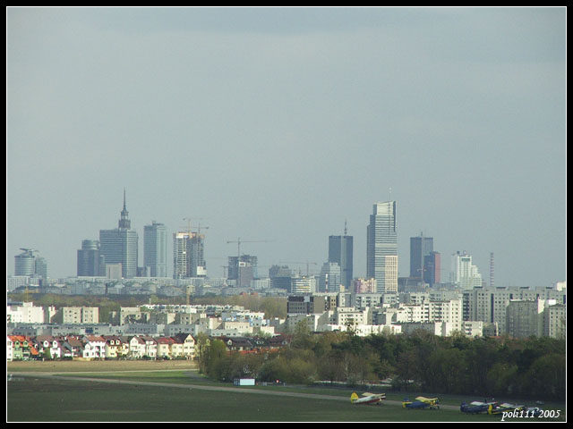
Panorama warsaw

Slide 3
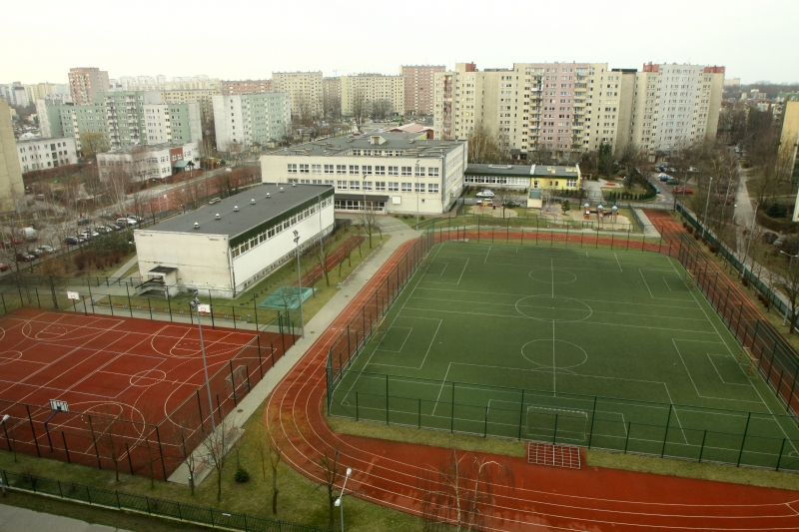
This is my school in Bemowo.

Slide 4
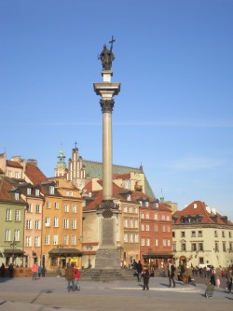
King Zygmunt III
Waza moved the capital from Krakow to Warsaw in XVII century.

Slide 5
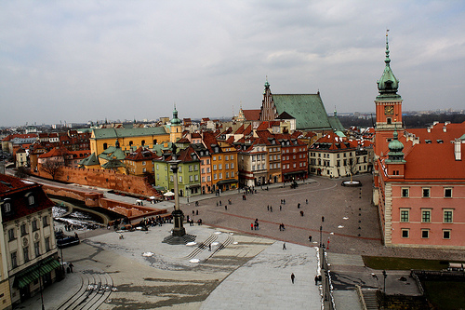
Old Town in Warsaw rebuilt after the II war.

Slide 6

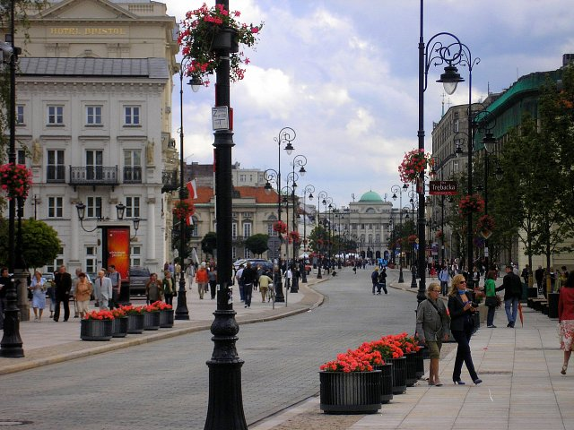
„Krakowskie PrzedmieScie” the most expensive street in Warsaw.

Slide 7
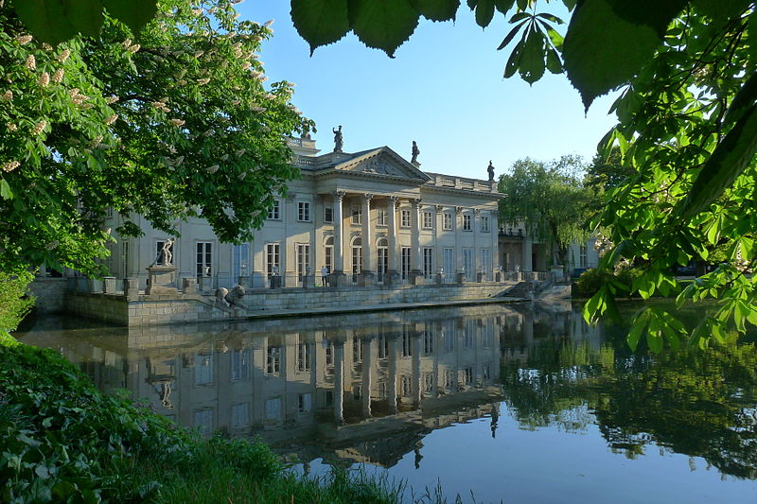
Palace on the Water in Lazienki Royal

Slide 8
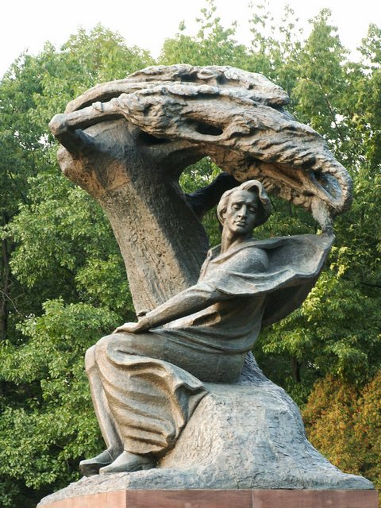
Monument to Frederic Chopin
IN Lazienki roYal, the greatest Polish composer.

Slide 9
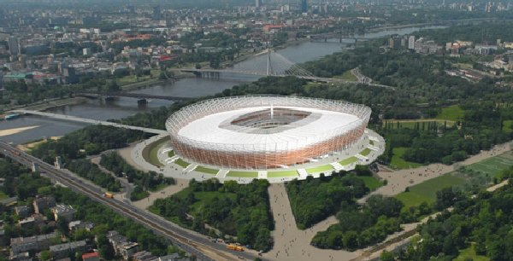
The National Stadium was built for Euro 2012

Slide 10

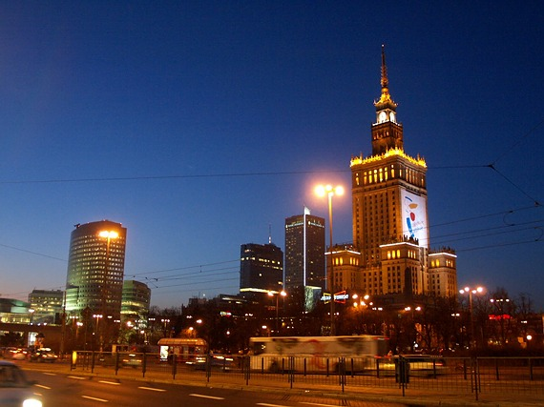
Please, visit warsaw

