Slide 1
This is Warsaw
In Poland

Slide 2
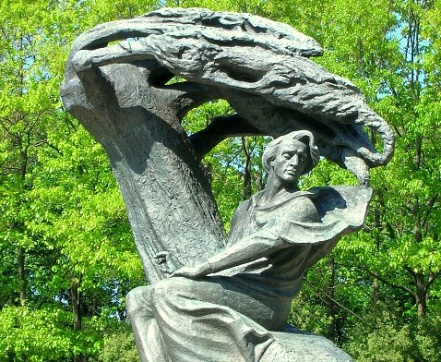
This is a monument of Frederic Chopin. It is located in the ,,lazienki’’ park in Warsaw.

Slide 3
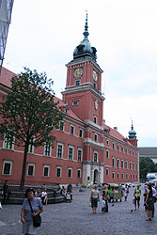
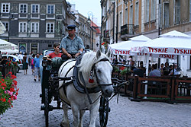
This is the Old Town

Slide 4
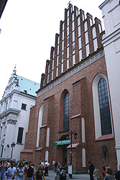
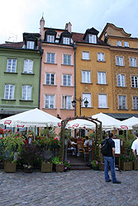
More pictures

Slide 5
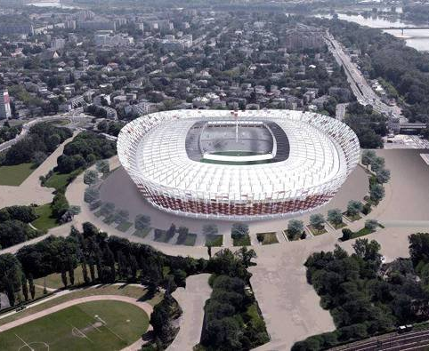
This is the national stadium in Warsaw
Here the EURO 2012 Championship will be held

Slide 6
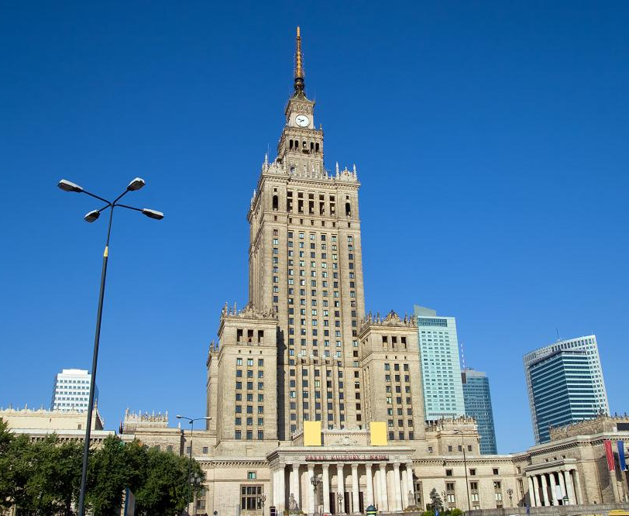
This is the Palace of Culture and Science in
Warsaw

Slide 7
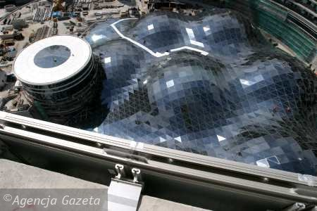
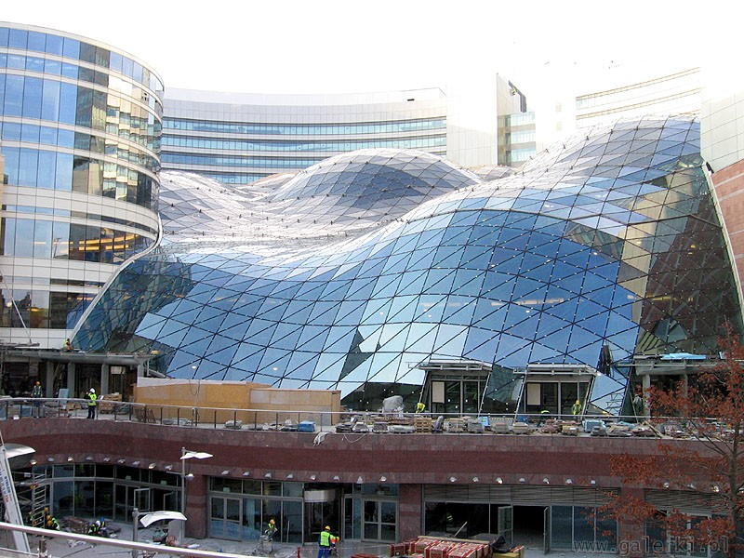
Golden Terraces shopping centre

Slide 8
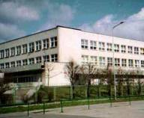
This is my school
I and my colleagues learn here

Slide 9
…the end
It seems that this is …

